Slide 1




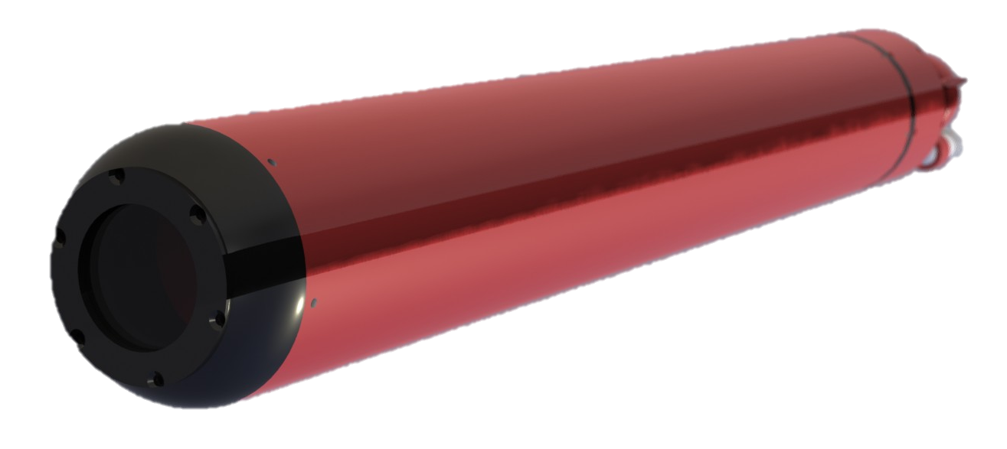
Micro Subglacial Lake Exploration Device (MSLED)
Student: Daming Chen
Mentor: Dr. Alberto Behar
http://extremerobotics.lab.asu.edu

Slide 2
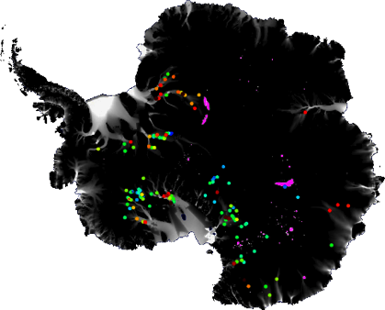
Antarctic Subglacial Lakes
Located deep beneath ice sheet in bedrock
Part of an interconnected system of water drainage
Influences ice sheet movement and melt
May harbor unique ecosystems
Analog for extraterrestrial bodies
Whillans
Ice Stream

Slide 3
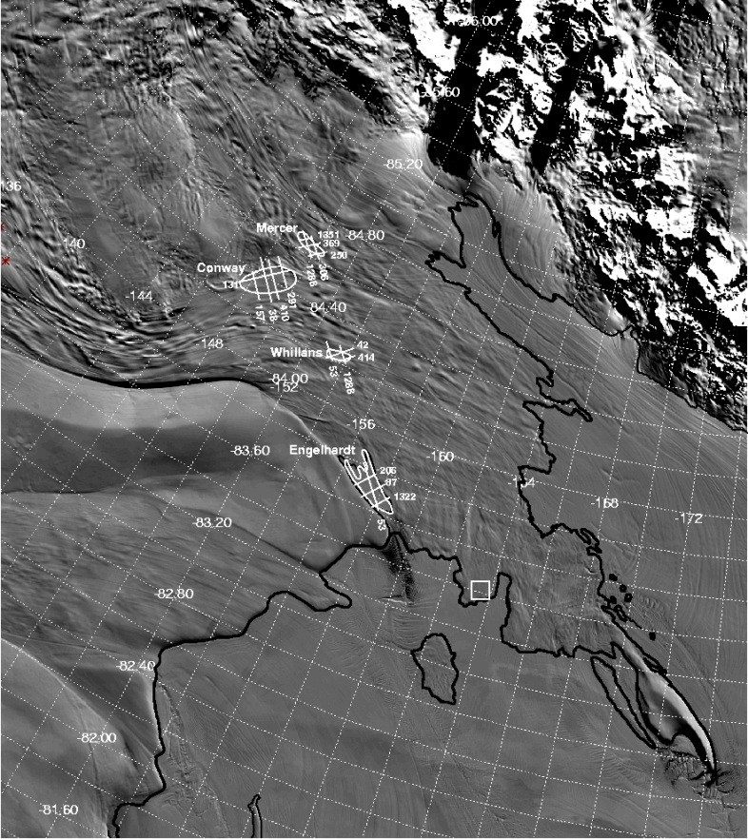
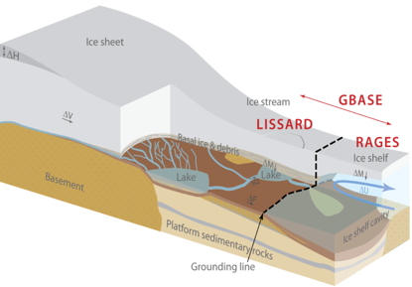
WISSARD Project
Whillans Ice Stream Subglacial Access Research Drilling
  GeomicroBiology of Antarctic Subglacial Environments (GBASE)
  Lake and Ice Stream Subglacial Access Research Drilling (LISSARD)
  Robotics Access to Grounding-zones for Exploration and Science (RAGES)
Notes:
Ross Ice SHelf

Slide 4
MSLED Objectives
Investigate water-ice interface
Determine structure of water column
  Physical: Pressure and temperature
  Chemical: Salinity and pH
  Visual inspection
Visually investigate lake floor for geologic and sedimentary processes
Look for biological features

Slide 5
System Requirements
Operate for minimum 2 hr
Two-way communication with surface in real-time
Return to the borehole for retrieval
Operate in temperatures from -10°C to 50°C
Utilization of commercial-off-the-shelf components
Withstand decontamination for clean access
Utilization of existing infrastructure (Ice Borehole Probe)
Sensors: high resolution video, temperature, salinity and pressure
Operational range of 1 km
Operating at depth up to 1.5 km
Maximum 8 cm diameter and 70 cm length
Remotely operated from surface
Localization of measurements
Notes:
Form factor constraints (borehole, mission)
High pressures (environment)
Low temperature (environment)
High bandwidth communication with surface (payload)

Slide 6
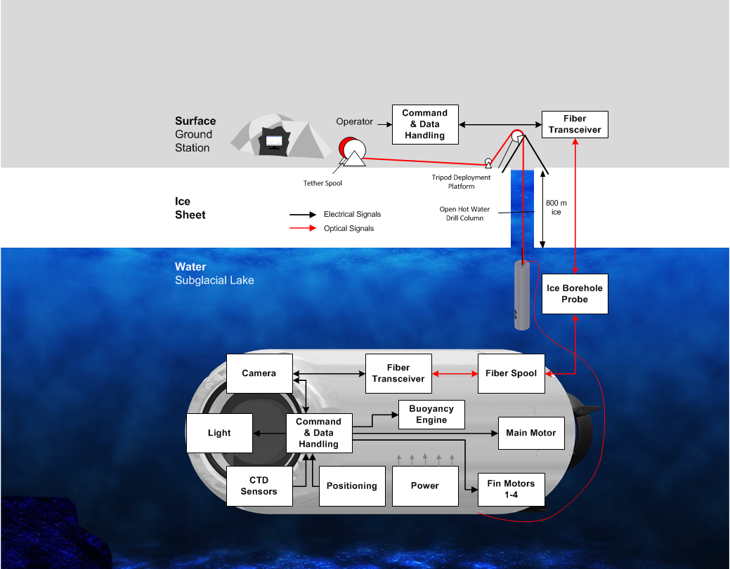
System Design
Background image: Flickr, WoaH

Slide 7

Structure
Main Motor Cavity
Electronics Compartment
Flooded Chamber for Fiber Spool
Liquid Compensated Servo Motors
Nose Cone
with Window
Propeller with
Kort Nozzle
Background image: Flickr, WoaH

Slide 8
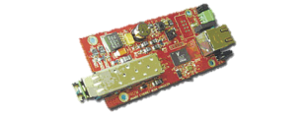
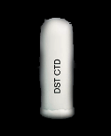






Internal Components
Fiber Transceiver
(Prizm TEL Series Gigabit )
CTD Sensor
(Star Oddi CTD DST)
LED light ring
(Cree XLamp XP-E)
Camera
(Prosilica GC1380C)
Buoyancy
Engine
IMU
(MicroStrain 3DM-GX3-25)
Brushless Motor
(Exceed RC Optima)
Battery Pack
(SAFT LSH 14)
Command and Data Handling
(ATmega2560)
Fiber Spool (Linden Photonics)
Fin Servos
Background image: Flickr, WoaH

Slide 9
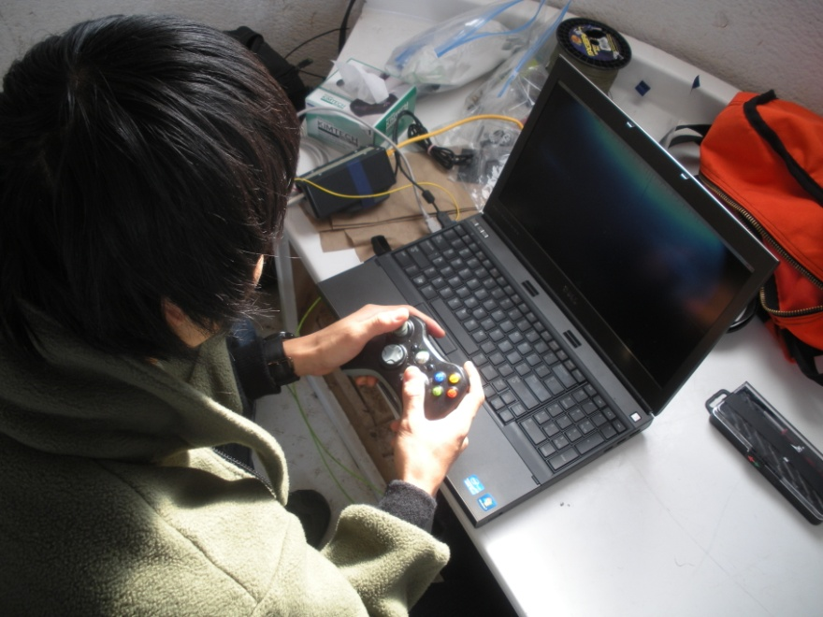
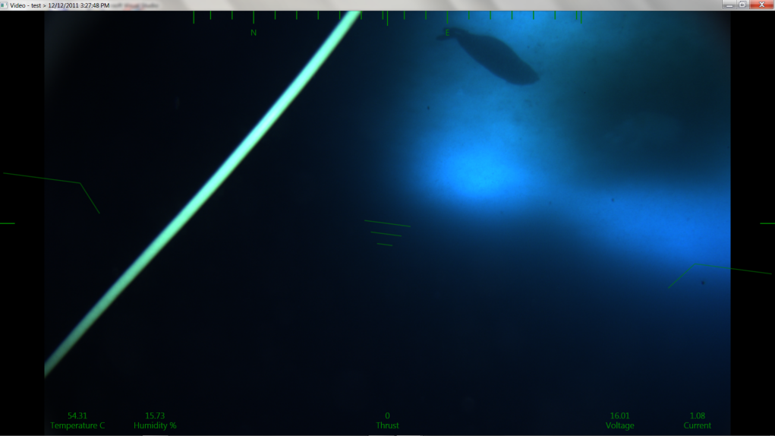
Software Design
Controlled through the fiber optic connection from MSLED
Software written in C# and makes use of the XNA framework to communicate with XBOX360 controller
Draws bitmaps to screen from camera API, with OSD overlay on top for temperature, humidity, thrust, voltage, current, heading, and pitch

Slide 10
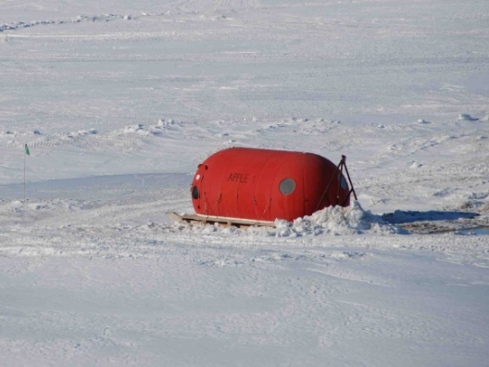
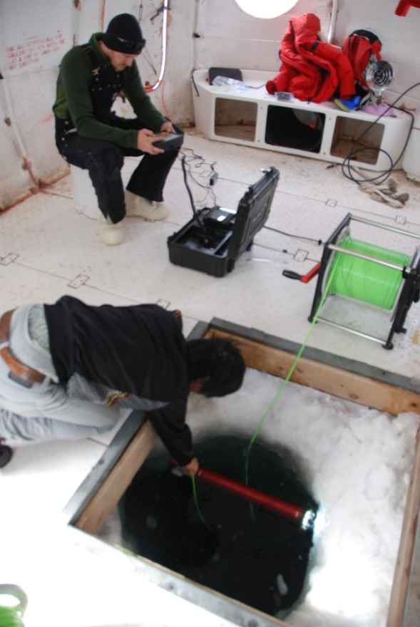
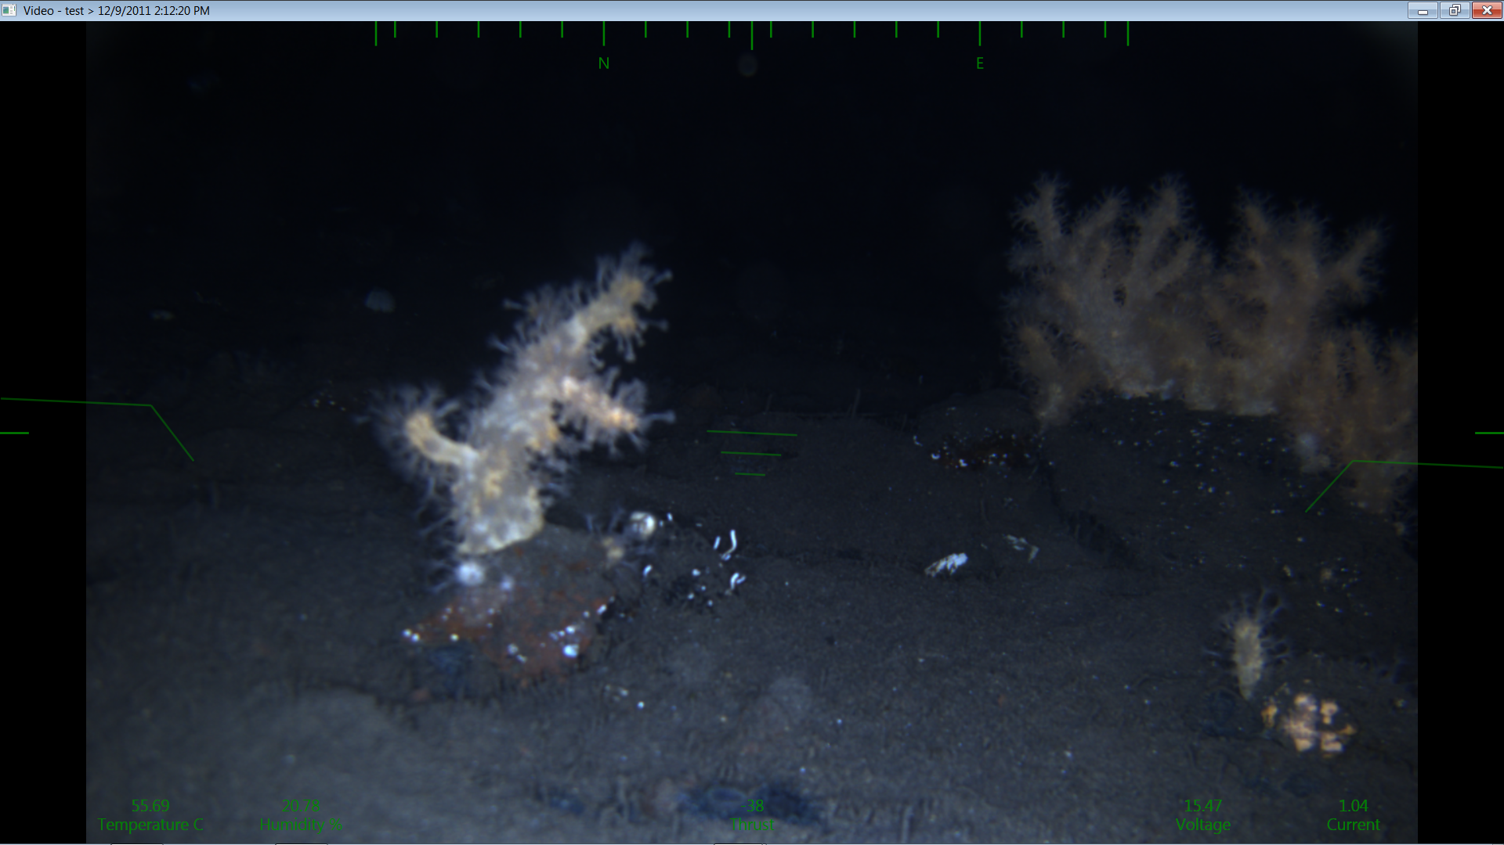
Antarctic Testing

Slide 11
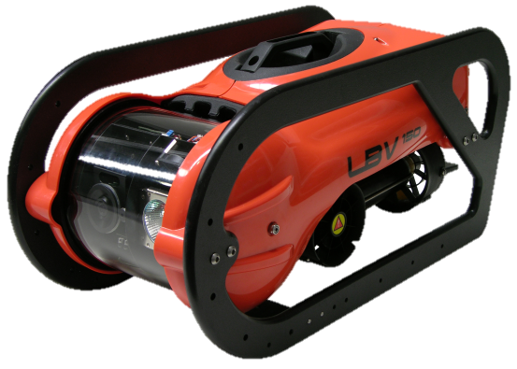
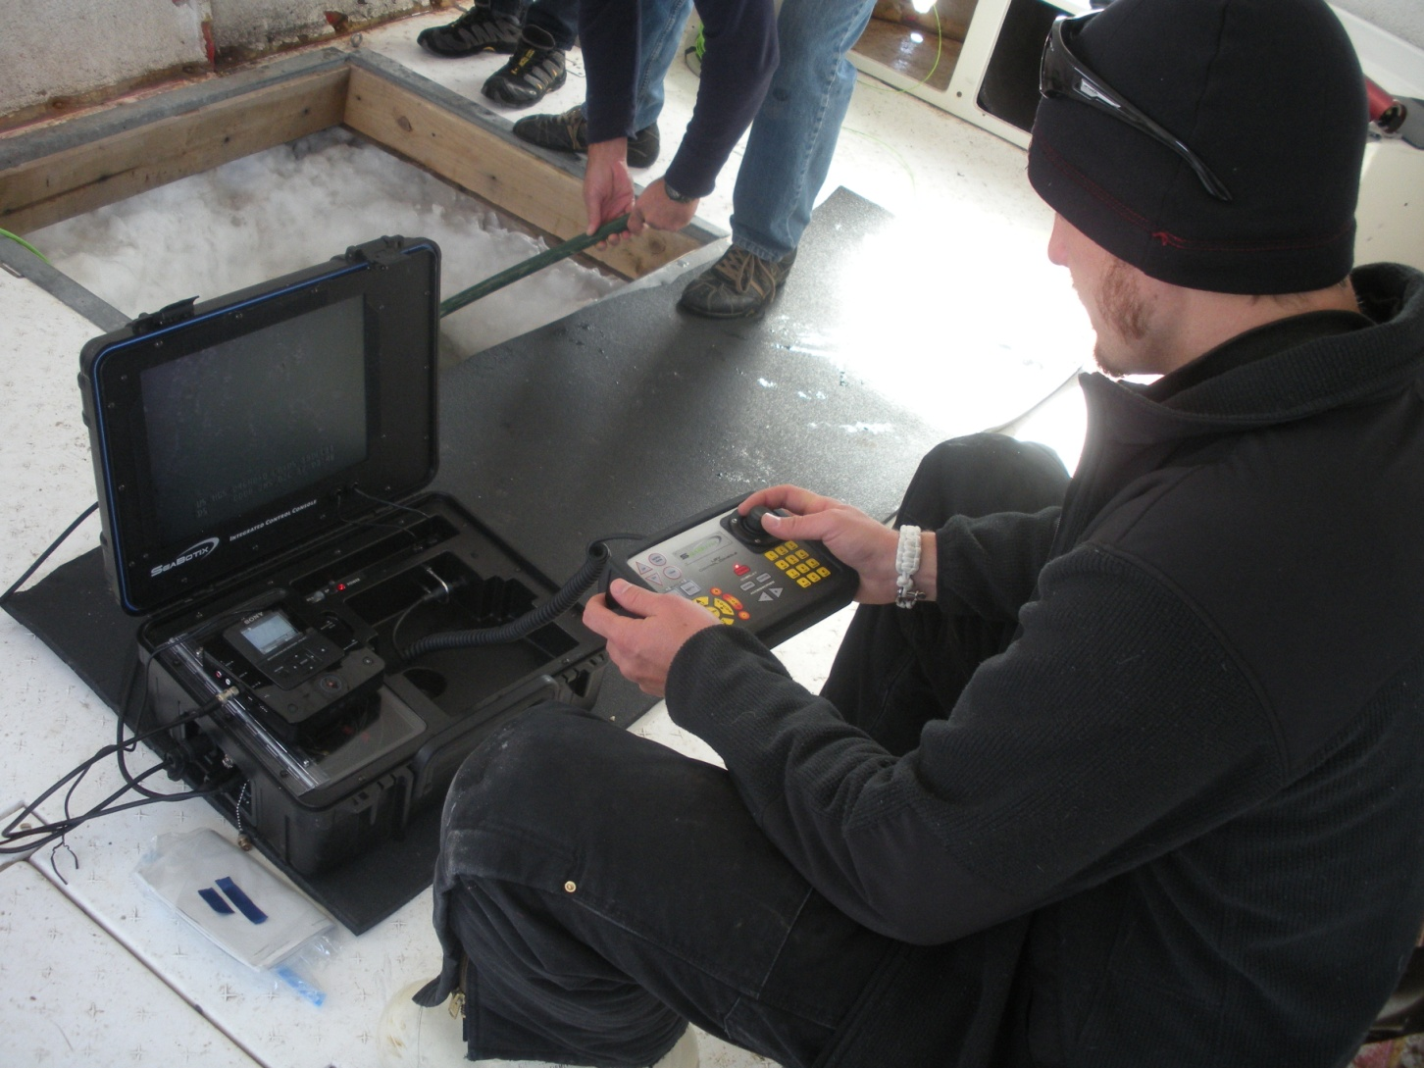
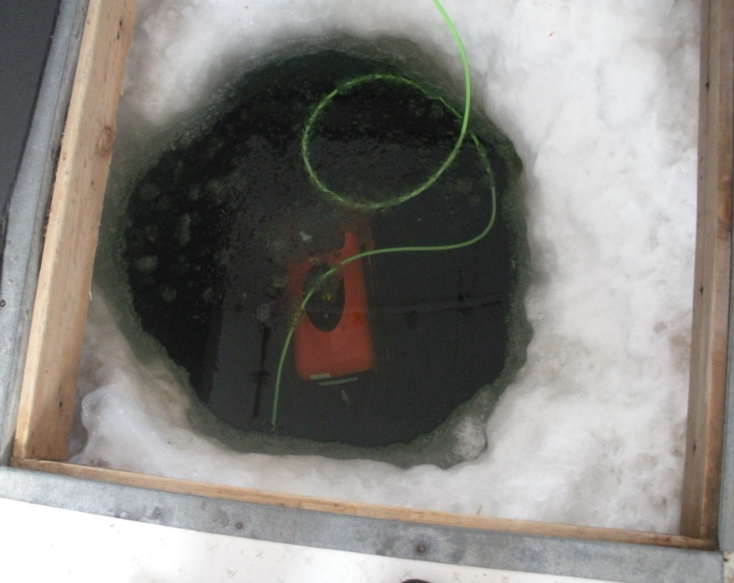
Chase Vehicle

Slide 12
Current Status
2011 – Field Test Deployment
  McMurdo Station (November-December)
2012 – Possible re-test
  McMurdo Station with full system
2013/2014 – Field Deployment
  WISSARD:
    Whillans Ice Stream Antarctica
Ongoing Testing
  Lake Tahoe
  Crater Lake
  Arizona Lakes
  Pools

Slide 13
Questions & Comments

